Slide 1
Database Systems

Slide 2
Course Description
This is an introductory course to database, its main aim is to introduce database to students as the heart of most business applications. The course focuses on database design, modeling and database language SQL.
Books:
Database Systems, Thomas Connolly & Carolyn Begg, 4th Edition, ,2008. Modern Database Management, Jeffrey A. Hoffer, Mary B. Prescott , null Edition, ,2008.
Database Systems Models, Languages, Design, and Application Programming. 6th edition, Ramez Elmasri & Shamkant Navathe.
Fundamentals of Database Systems, Elmasri and Navathe

Slide 3
Course Objectives
Introduce the concept of DBMS and its purpose.
Introduce the main concepts in a Database (Tables, records, fields, primary key, foreign key, relation etc.)
Learn how to design a logical database model, convert the logical database designs to physical designs (Mapping), and develop the physical database.
Enhance the student's modeling and abstraction skills.
Introduce the concepts of Entities, Attributes and Relations.
Introduce Relational algebra and SQL.
Introduce the concept of normalization theory (1NF, 2NF, and 3NF).
Enable students to build a desktop application with a database.
Enhance students skills including: team working, problem-solving, and self-learning.

Slide 4
Chapter 1: Introduction to Databases
The goal of this chapter is to provide basic terms and concepts related to Databases.

Slide 5
Why to Study Databases?
Databases are an essential component of life in modern society.
We interact with databases in many daily activates, such as:-
Banking transactions: open an account, deposit, withdraw, transfer, etc.
Hotel or airline reservation.
E-commerce, buy or sell online.
Search for a book in the library.

Slide 6
Types of Databases and Database Applications
Traditional database applications
Store textual or numeric information
Multimedia databases
Store images, audio clips, and video streams digitally
Geographic information systems (GIS)
Store and analyze maps, weather data, and satellite images

Slide 7
Database Definition
A database is a shared collection of logically related data that is stored to meet the requirement of different users of an organizations
Notes:
Logically related: Context from which database is going to use

Slide 8
What is Data?
Data are known facts about something that can be recorded.
Some examples of data are:
Names
Telephone numbers
Addresses.
Data are values of some type; integer, float, string, image, .. Etc.
How to store those Data?

Slide 9
Database Definitions
A database:
Models a particular real world systems in the computer in form of data called Miniworld or universe of discourse (UoD)
Logically coherent(well organized) collection of data with inherent meaning
Designed, built and populated with data for a specific purpose
Example of a commercial database
Sales system, Cash handling system, reservation system
Amazon.com

Slide 10
What is a DBMS?
A Database Management System (DBMS) is a collection of programs that enables users to create and maintain a database.
A DBMS is a general purpose software system that facilitates the processes of defining, constructing, manipulating, and sharing databases among various users and applications.

Slide 11
Typical DBMS Functionality
Define a database : in terms of data types, structures and constraints
Construct or Load the Database on a secondary storage medium
Manipulating the database : querying, generating reports, insertions, deletions and modifications to its content
Concurrent Processing and Sharing by a set of users and programs – yet, keeping all data valid and consistent

Slide 12
What is an Application?
An Application program accesses the database by sending queries or requests to the DBMS.
A query causes some data to be retrieved.
A transaction may cause some data to be read and some data to be written into the database.

Slide 13
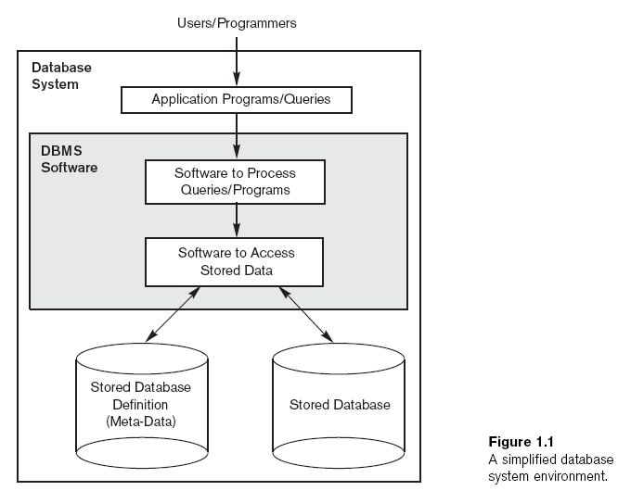

Slide 14
A Bit About History
Computer initially used for computational/ engineering purpose
Commercial applications introduces File Processing System
The application which involve data processing as a basic activity rather than computation

Slide 15
File Processing (FPS)
FPS is a collection of programs that perform services for the end users such as production of reports
In a TFP(Traditional file processing) system, each user defines and implements the files needed for a specific software application.
This redundancy in defining and storing data results in wasted storage space and in redundant efforts to maintain common up-to-date data.

Slide 16
File Processing (FPS)
Registration System
Library System
Examination
Registration Application
Library Application
Examination Application
Registration data File
Library data File
Examination data File
Program data dependence

Slide 17
File Processing (FPS)
Registration
Reg. No
Name
Father Name
Phone
Address
Class
Library
Reg. No
Name
Father Name
Book issued
Fine
Examination
Reg. No
Name
Address
Class
Semester
Grade
Data duplication
Waste storage
Vulnerable to data inconsistency

Slide 18
Database Approach
A single repository maintain data defined once and accessed by various users
Registration System
Library System
Examination System
Registration Application
Library Application
Examination Application
DBMS
University Student DB
Notes:
In Database approach, a single repository maintains data that is defined once and then accesses by various users.

Slide 19
Main Characteristics of the Database Approach
Self-describing nature of a database system: A DBMS catalog stores the description of the database. The description is called meta-data. This allows the DBMS software to work with different databases.
Insulation between programs and data: Called program-data independence. Allows changing data storage structures and operations without having to change the DBMS access programs.

Slide 20
Main Characteristics of the Database Approach
Data Abstraction: A data model is used to hide storage details and present the users with a conceptual view of the database.
Support of multiple views of the data: Each user may see a different view of the database, which describes only the data of interest to that user.

Slide 21
Main Characteristics of the Database Approach
Sharing of data and multiuser transaction processing: allowing a set of concurrent users to retrieve and to update the database.
Concurrency control within the DBMS guarantees that each transaction is correctly executed or completely aborted. OLTP (Online Transaction Processing) is a major part of database applications.

Slide 22
When not to Use a DBMS:
Since a DBMS comes with an overhead costs in:-
High initial investment in hardware, software, and training
Conversion cost - already a system could be manual or FPS
Overhead for providing security, concurrency control, recovery, and integrity functions.

Slide 23
When not to Use a DBMS:
Therefore, TFP approach can be a better choice
Simple, well-defined database applications that are not expected to change at all.
Real-time requirements for some application programs that may not be met because of a DBMS overhead.
Embedded systems with limited storage capacity such that the DBMS would not fit.
No multiple-user access is required.

Slide 24
Database Users
Users may be divided into those who actually use and control the content (called “Actors on the Scene”).

Slide 25
Actors in a Large Database
1. Database Administrators:
A Database Administrator (DBA) is responsible for authorizing access to the database, coordinating and monitoring its use, and acquiring software and hardware resources as needed.
The DBA is accountable for problems such as
Security breaches
Poor system response time.

Slide 26
Actors in a Large Database
1. Database Responsibilities
Software installation and Maintenance
Data Extraction, Transformation, and Loading
Database Backup and Recovery
Security
Authentication etc…

Slide 27
Actors in a Large Database
2. Database Designers:
Responsible for identifying the data to be stored in the database and for choosing appropriate structures to represent and store this data.
These tasks are performed before the actual implementation of the database.

Slide 28
Actors in a Large Database
3. End Users:
Are people whose job require access to the database for querying, updating, and generating reports.
The database primarily exists for this use.

Slide 29
Actors in a Large Database
4. System Analysts and Application Programmers (Software Engineers/ Developers)
System analysts determine the requirement of the end users. Application programmers implement these specifications as programs, then they test, debug, document, and maintain the system.
(This what you will do in this course project!)

Slide 30

Component of Database Application
Software
Interact
End users
…
Application
Program
Develop
Application
developer
What to get
DBMS
Maintain
DB
Administrator
How to get date
Database
DB Designer
Design
Data
Users

Slide 31
Advantages - Using the DBMS Approach
Controlling Redundancy
Redundancy is to store the same data in different files for no need. Redundancy caused TFPs to waste storage space, to require duplication of effort for multiple updates (waste time), and to perhaps show inconsistent data.
Inconsistency is to show different values for the same data item in different places.

Slide 32
Advantages - Using the DBMS Approach
Restricting Unauthorized Access
A DBMS provides a security and authorization subsystem, which the DBA uses to create accounts and to specify account restrictions. Then, the DBMS enforces these restrictions automatically.

Slide 33
Advantages - Using the DBMS Approach
Providing Storage Structures and Search Techniques for Efficient Query Processing
A DBMS uses indexes, files based on tree data structures or hash data structures that are suitably modified for disk search, to speed up disk search.

Slide 34
Advantages - Using the DBMS Approach
Providing Backup and Recovery
The backup and recovery subsystem of the DBMS allows to take backups, dated copies of the database, and to recover to a chosen backup copy in the case of hardware or software failure.

Slide 35
Advantages - Using the DBMS Approach
Enforcing Integrity Constraints
A DBMS provides capabilities for defining and enforcing integrity constraints, such as referential integrity, uniqueness, or business rules.
Examples are, When lending a book to a student, Student ID must exist in Student's table, Each Student ID must be unique.

Slide 36
Advantages - Using the DBMS Approach
Reduce Application Development Time
The time needed to develop an application using the DBMS approach is 400% -600% faster than the TFPs approach requires.

Slide 37
Advantages - Using the DBMS Approach
Flexibility
DBMS allows for some changes to the structure of the database with minimum affect or without affecting the stored data and the existing application programs.
However, in TFP approach any changes in the data structure requires corresponding changes in both file structure and applications programs.

